Slide 1
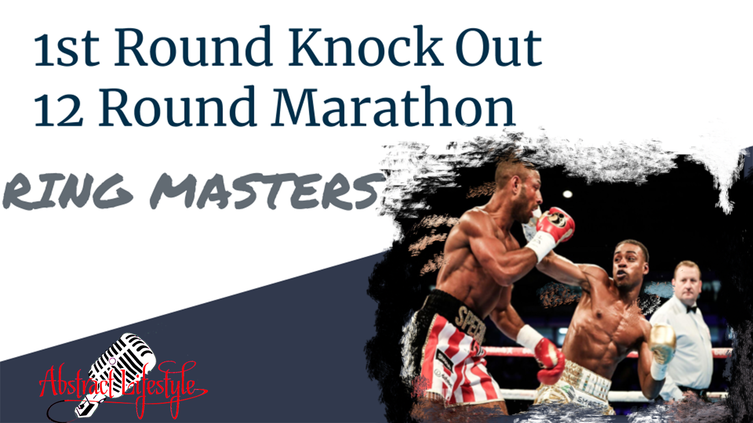

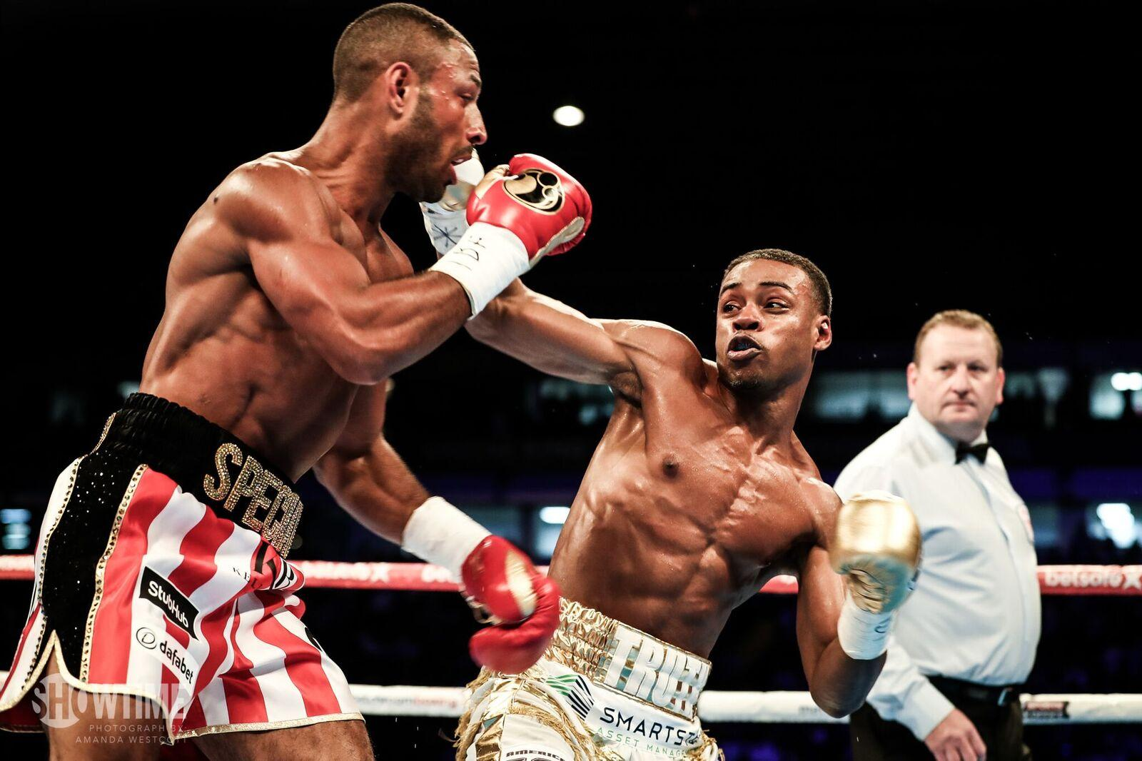
1st Round Knock Out
12 Round Marathon
RING MASTERS

Slide 2
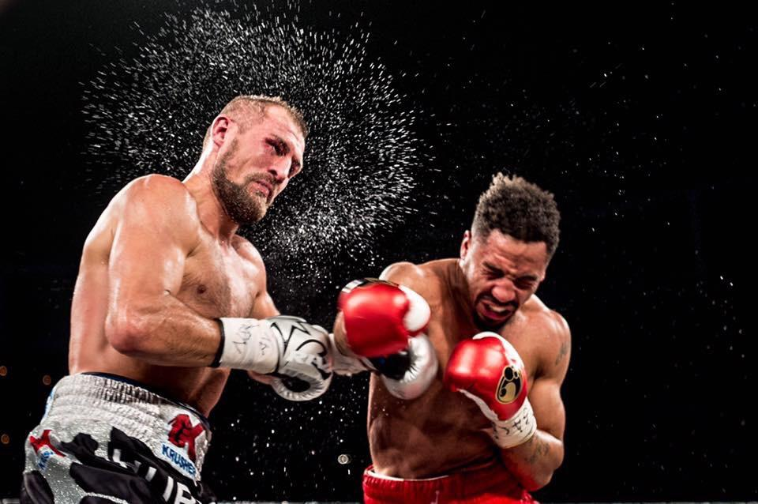

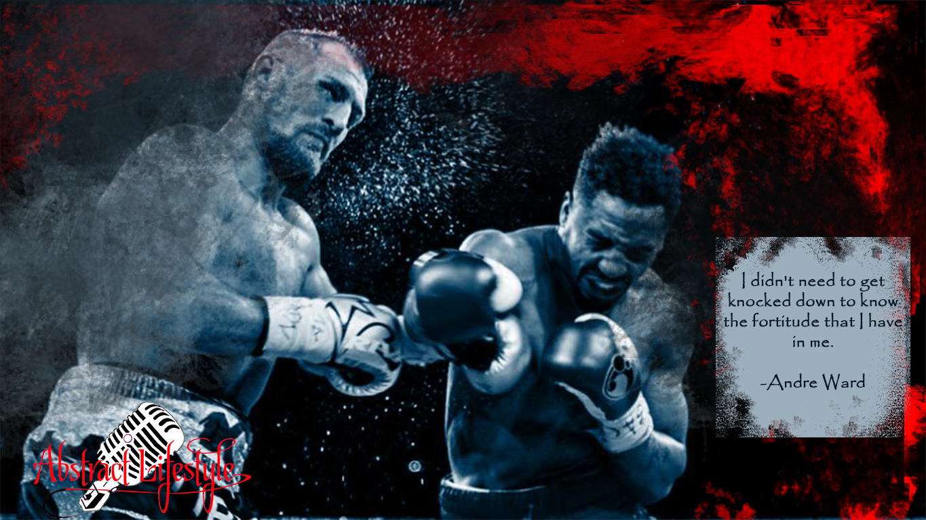

Slide 3
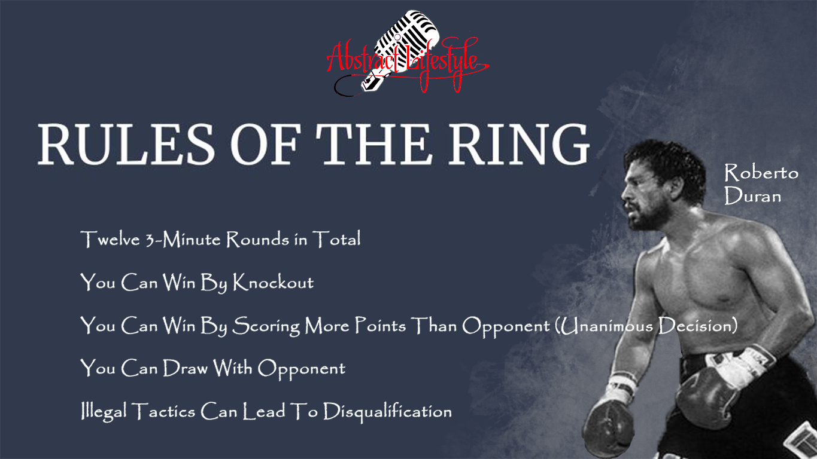
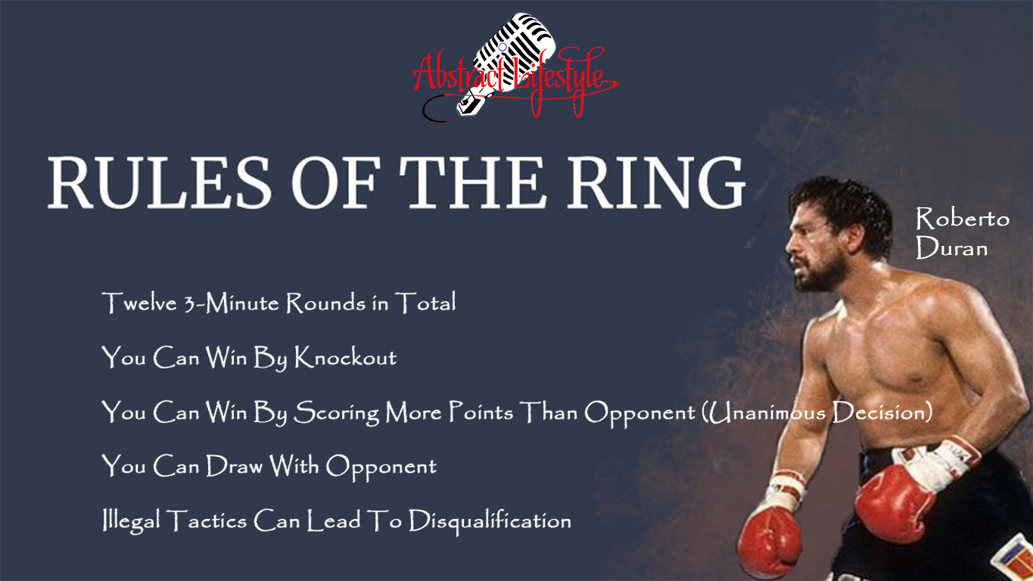
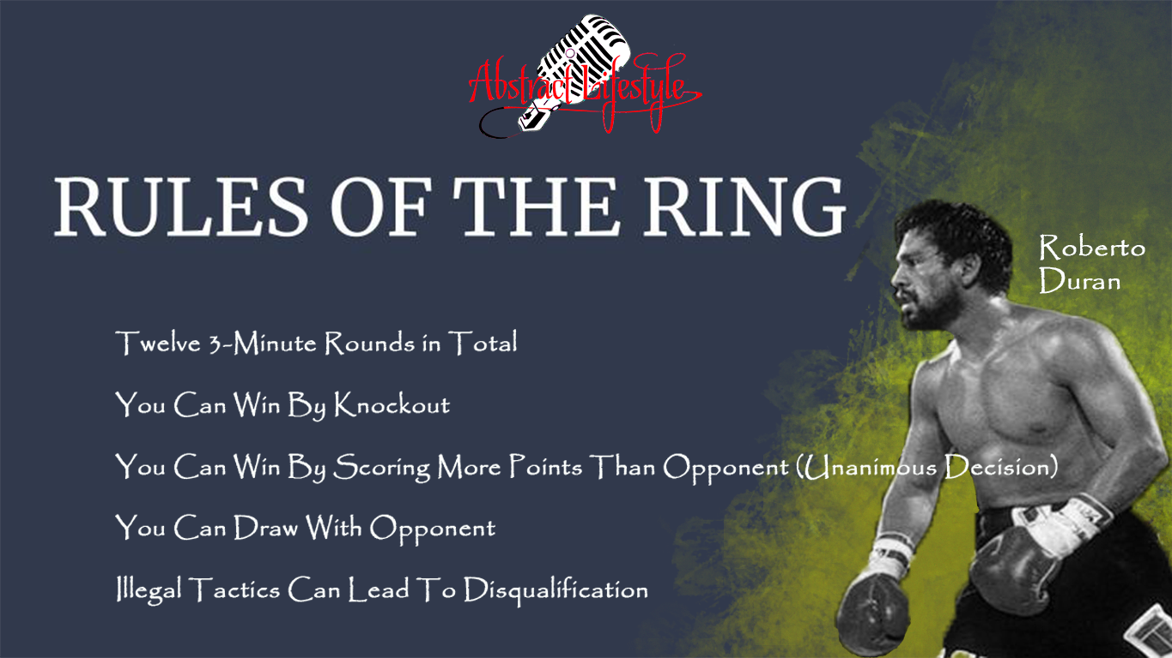
RULES OF THE RING

Slide 4

HOW DOES THIS APPLY TO CLASS?

Slide 5
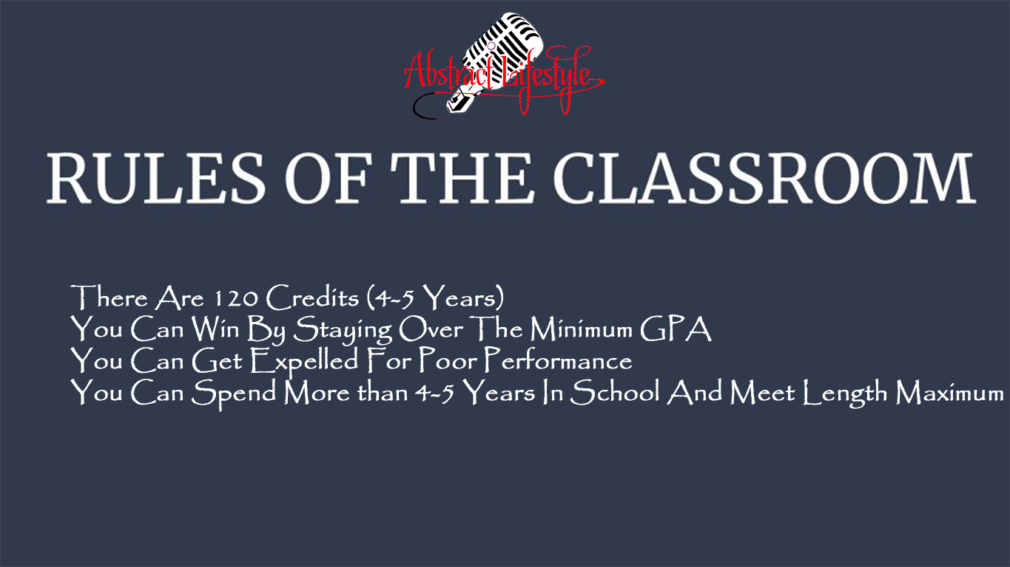
RULES OF THE CLASSROOM
There Are 120 Credits (4-5 Years)
You Can Win By Staying Over The Minimum GPA
You Can Get Expelled For Poor Performance
You Can Spend More than 4-5 Years In School And Meet Length Maximum

Slide 6
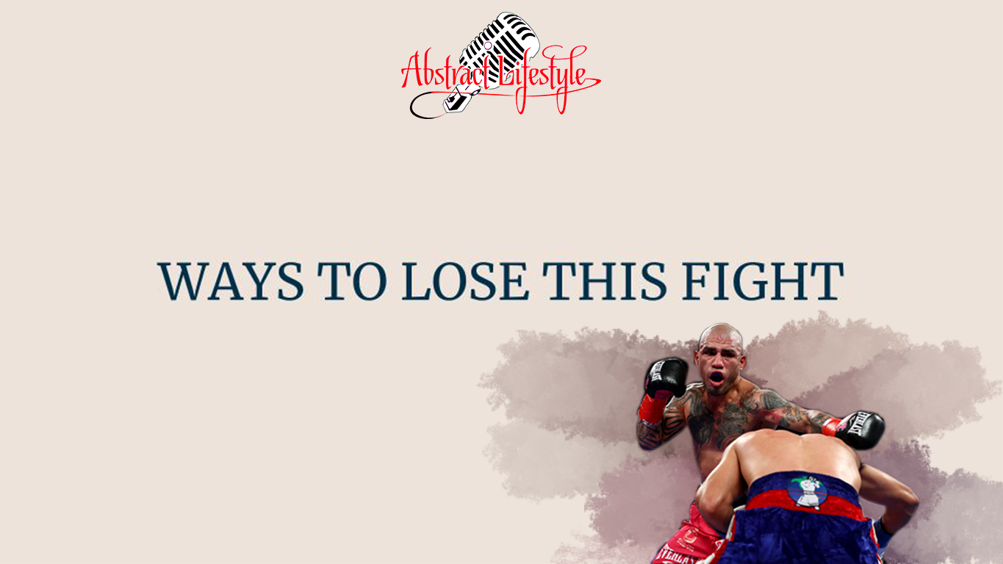
WAYS TO LOSE THIS FIGHT

Slide 7
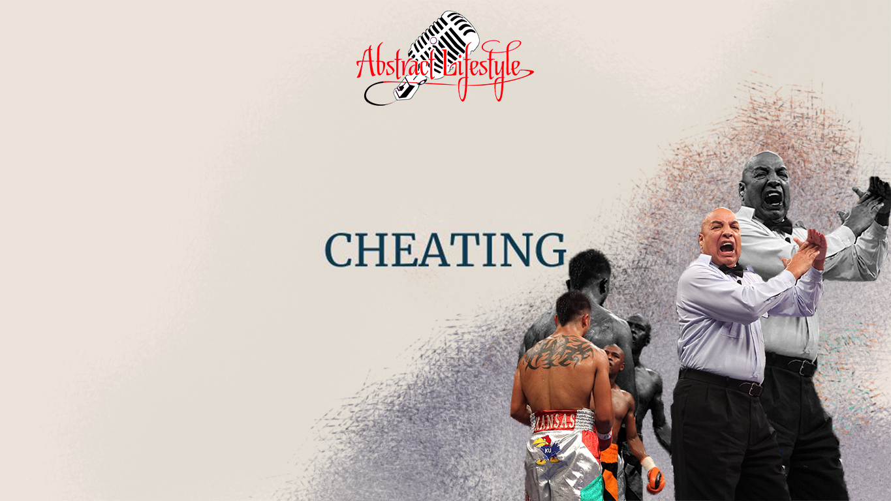
CHEATING

Slide 8
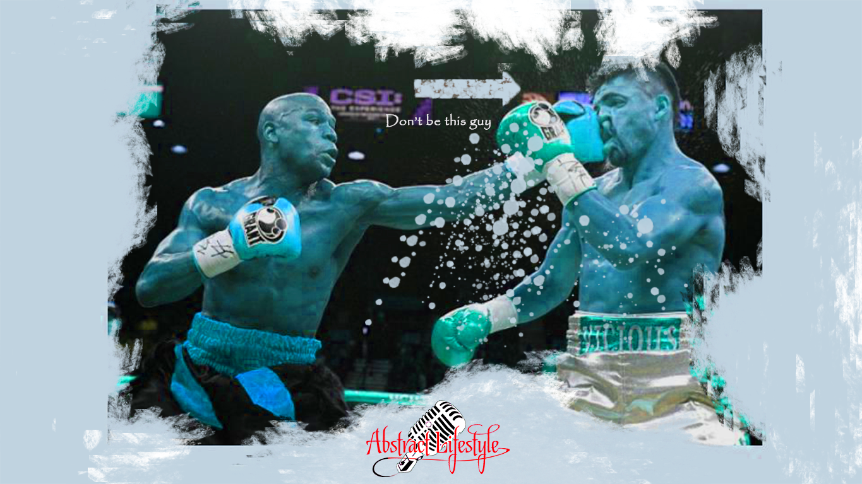
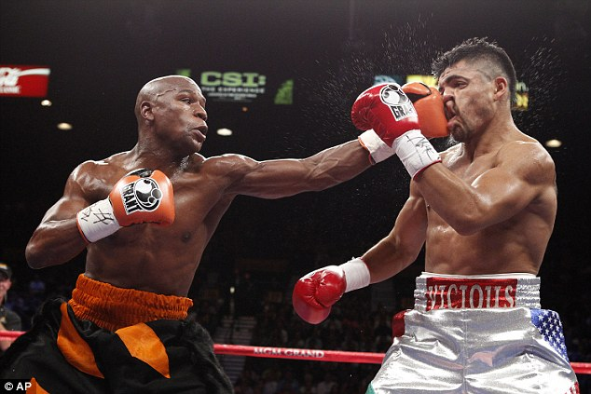
DONT BE THIS GUY
<https://www.youtube.com/watch?v=MjfHuAVig9g>
<https://www.youtube.com/watch?v=MjfHuAVig9g>

Slide 9
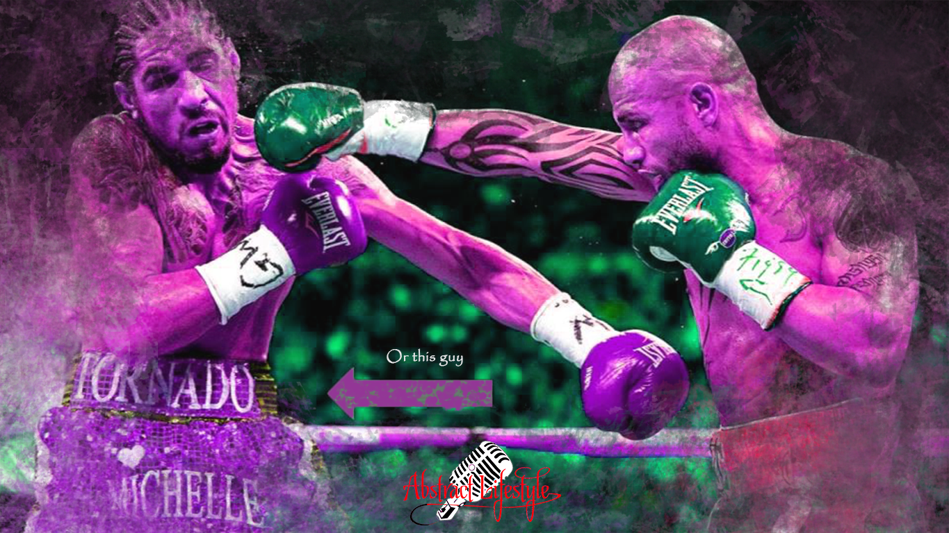

Slide 10
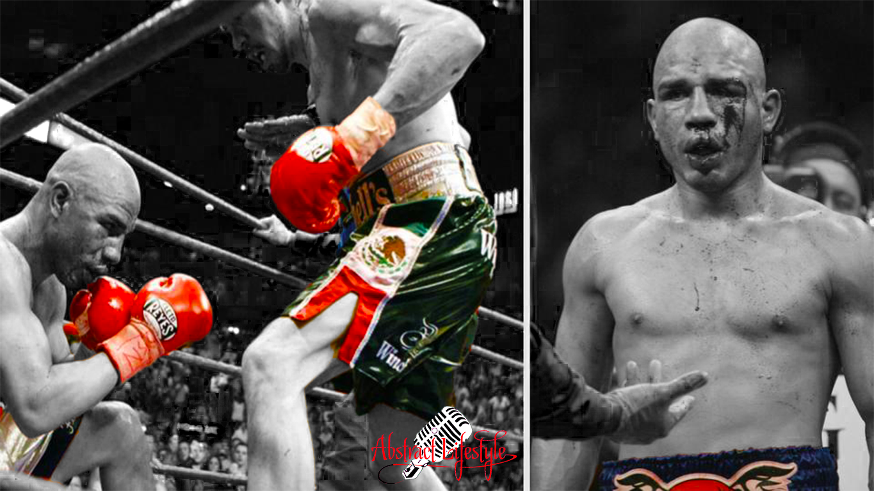

Slide 11
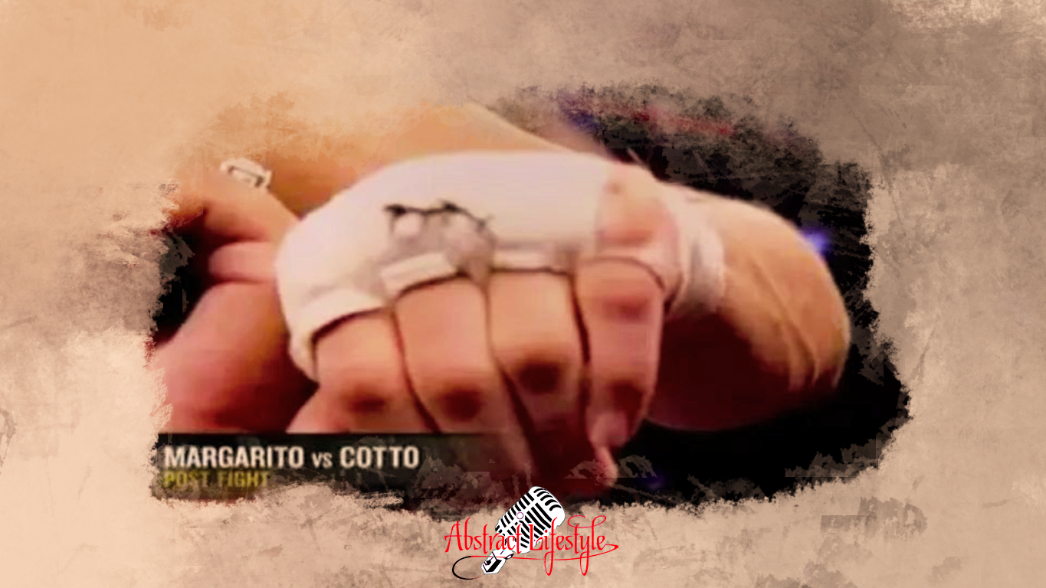
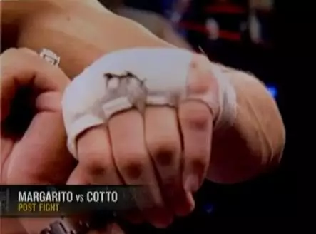

Slide 12
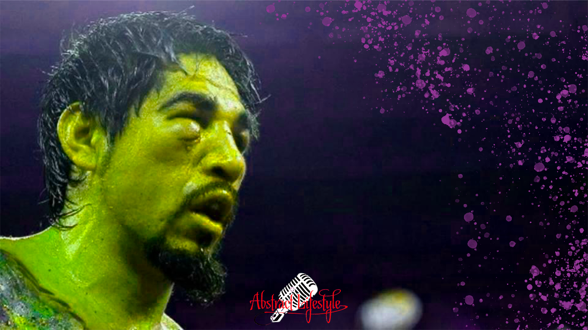
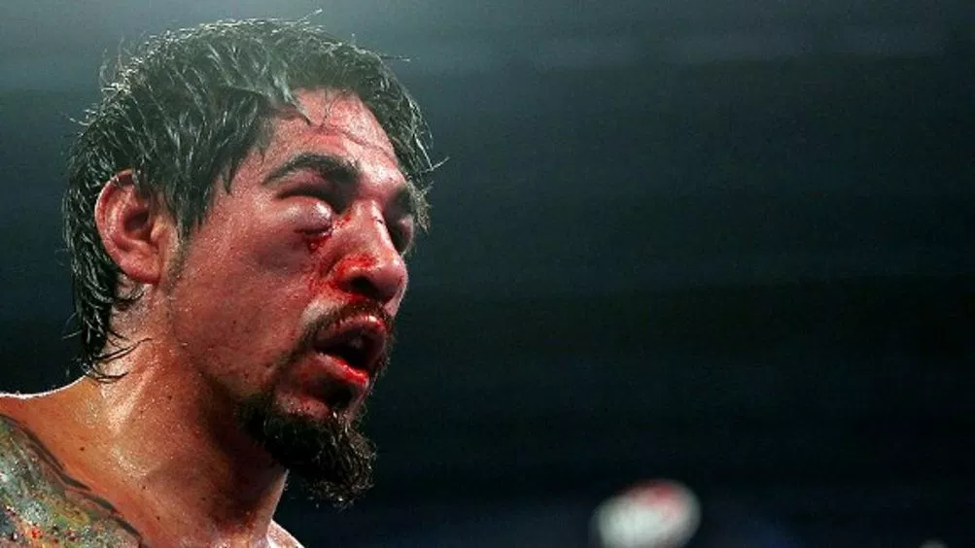
<https://www.youtube.com/watch?v=k7jHp7ahM3s>

Slide 13
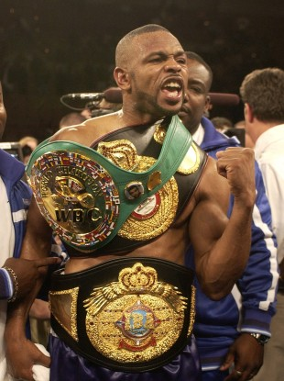
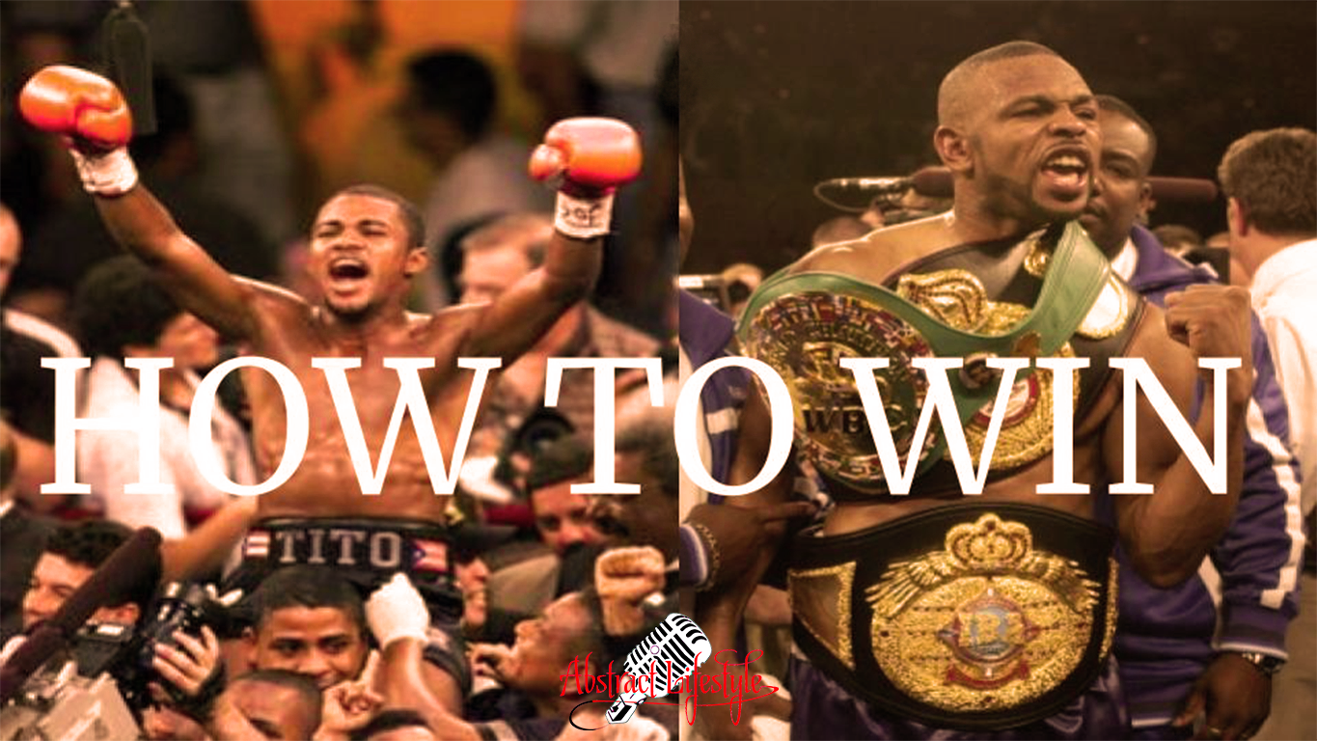
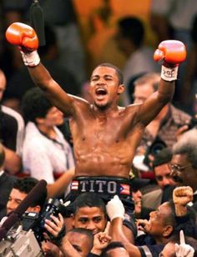
HOW TO WIN

Slide 14
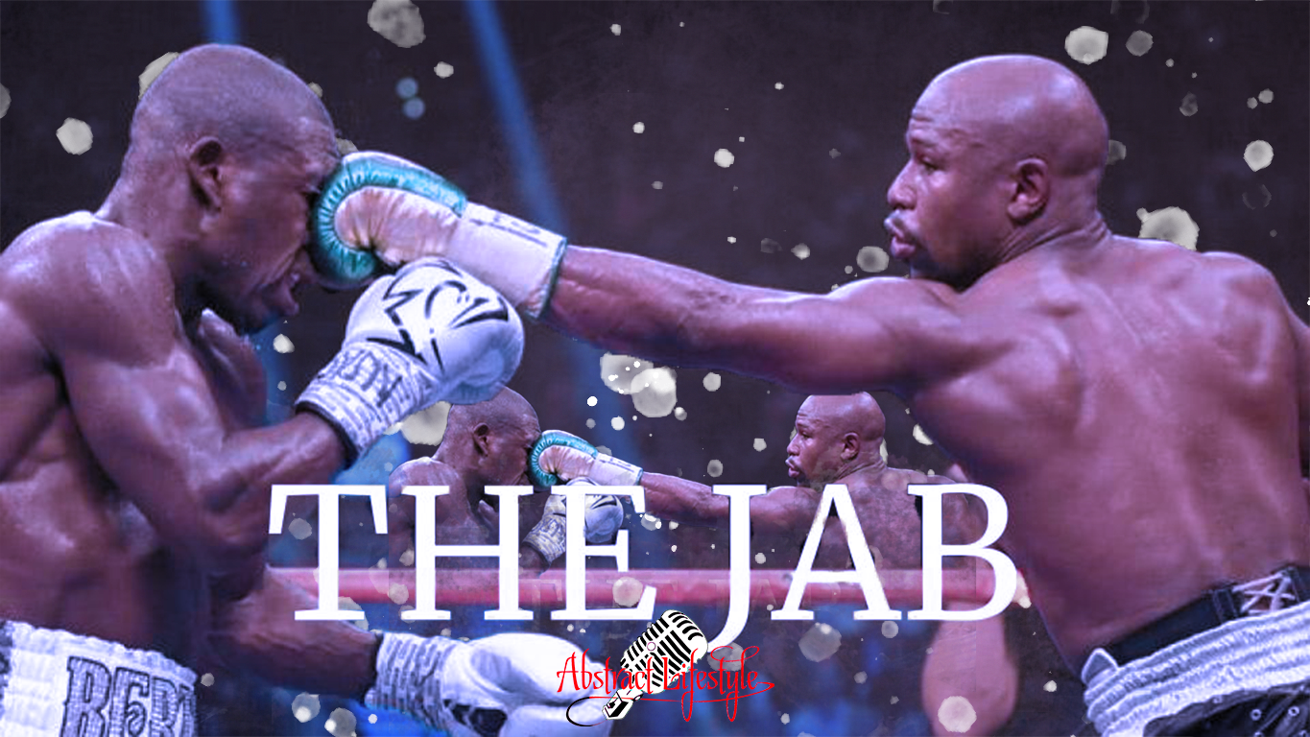
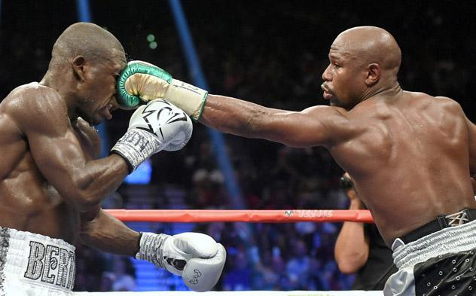
THE JAB

Slide 15
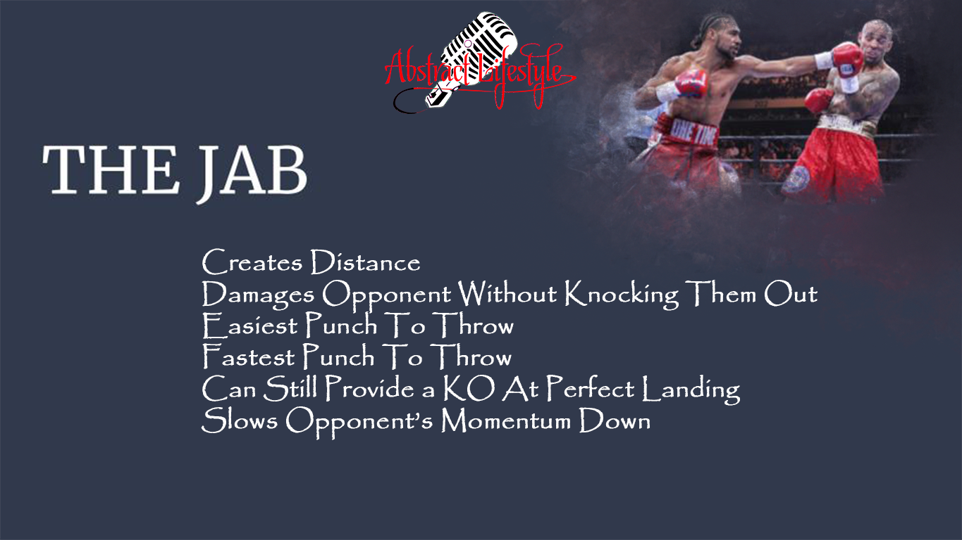
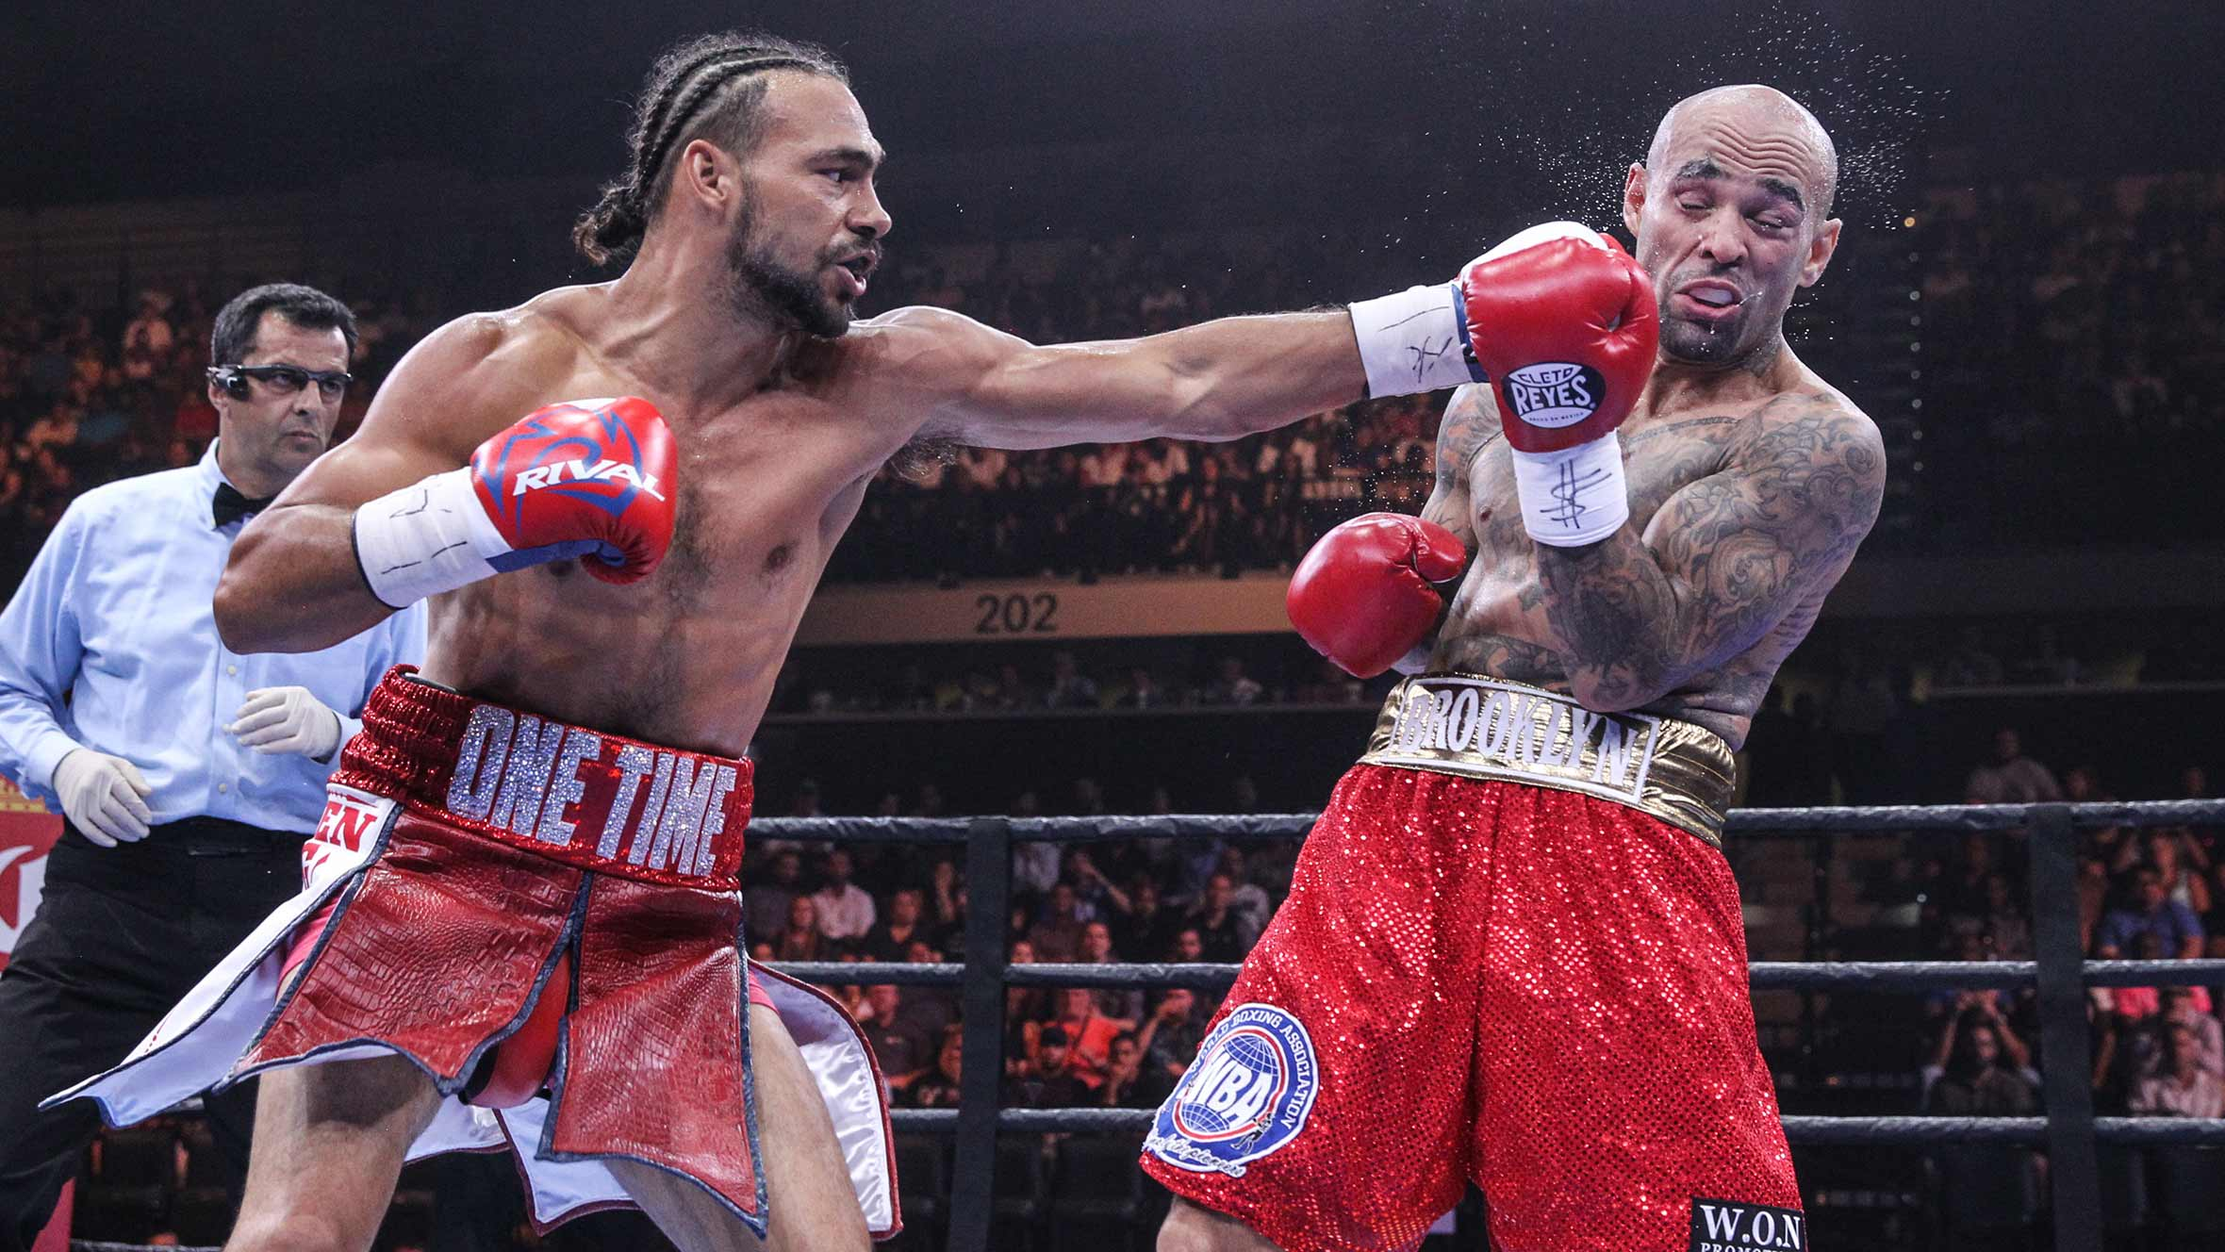
THE JAB
Creates Distance
Damages Opponent Without Knocking Them Out
Easiest Punch To Throw
Fastest Punch To Throw
Can Still Provide a KO At Perfect Landing
Slows Opponent’s Momentum Down

Slide 16

AND

Slide 17

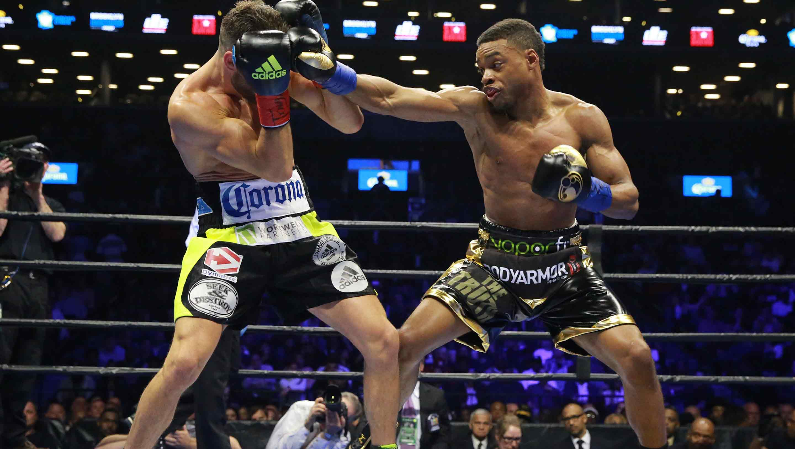
ERROL SPENCE JR.
24-0-0
21 KOs
ITS A GREAT SETUP PUNCH

Slide 18

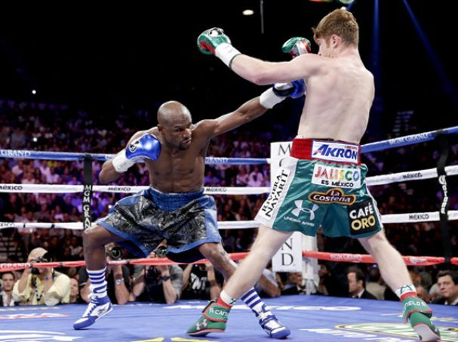
THE JAB
Attend All Your Classes
Show Up On Time
Pay Attention
Ask Questions When You Don’t And Do Understand Something
Participate Frequently
Build Relationships With Professors, Peers & Tutors

Slide 19

THE SLIP

Slide 20

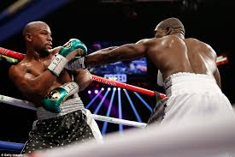
THE SLIP

Slide 21
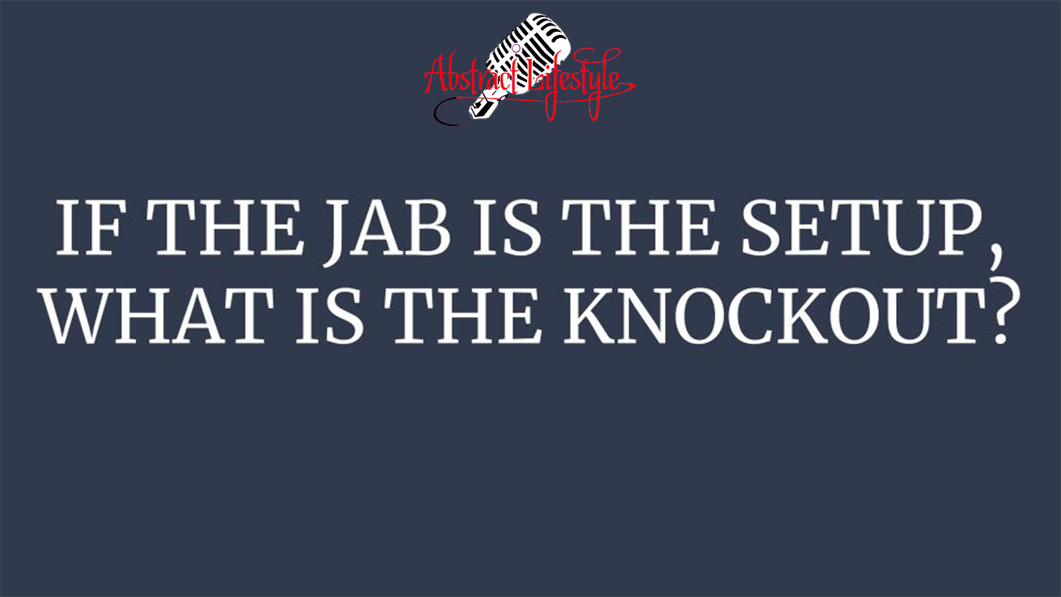
IF THE JAB IS THE SETUP, WHAT IS THE KNOCKOUT?

Slide 22
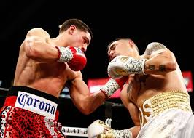
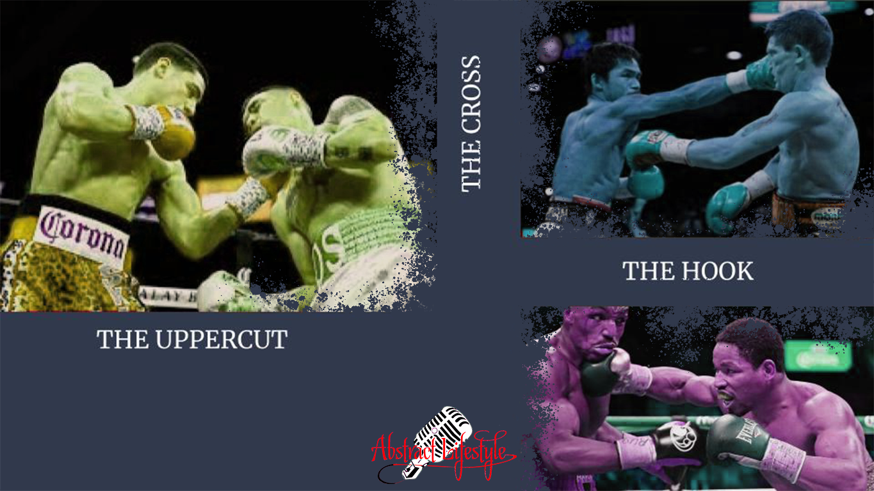
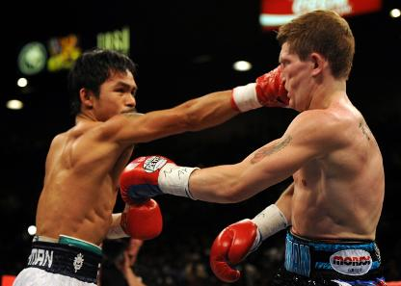
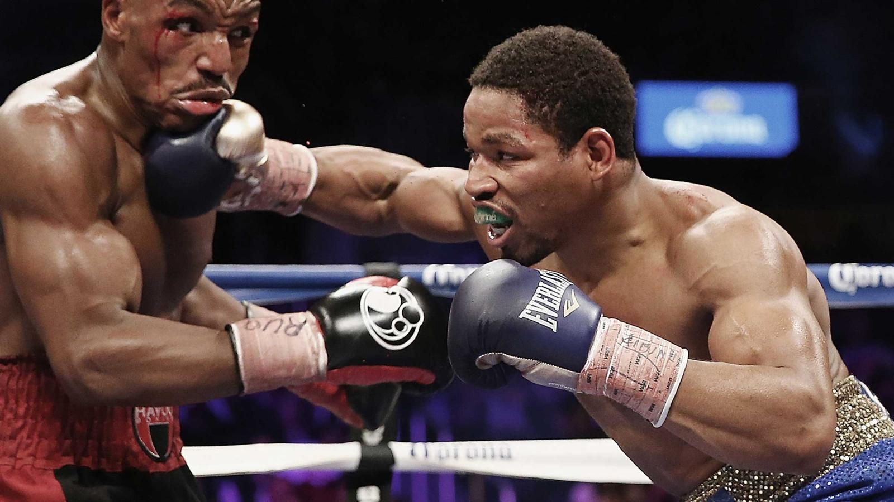
THE CROSS
THE HOOK
THE UPPERCUT

Slide 23


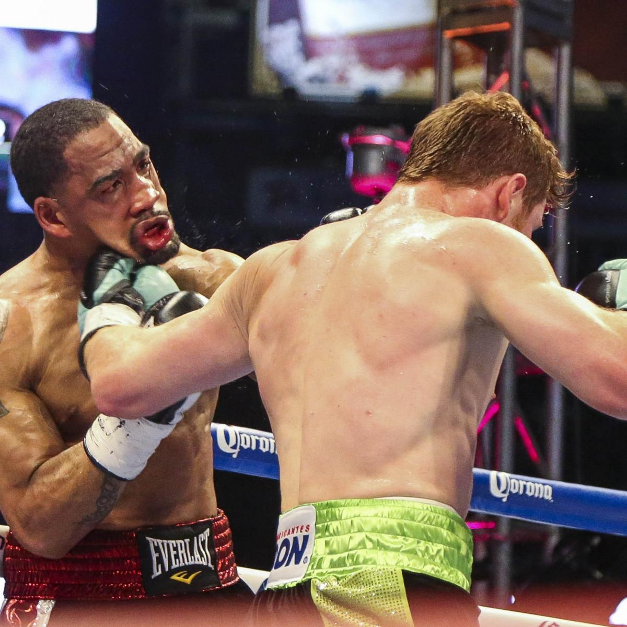
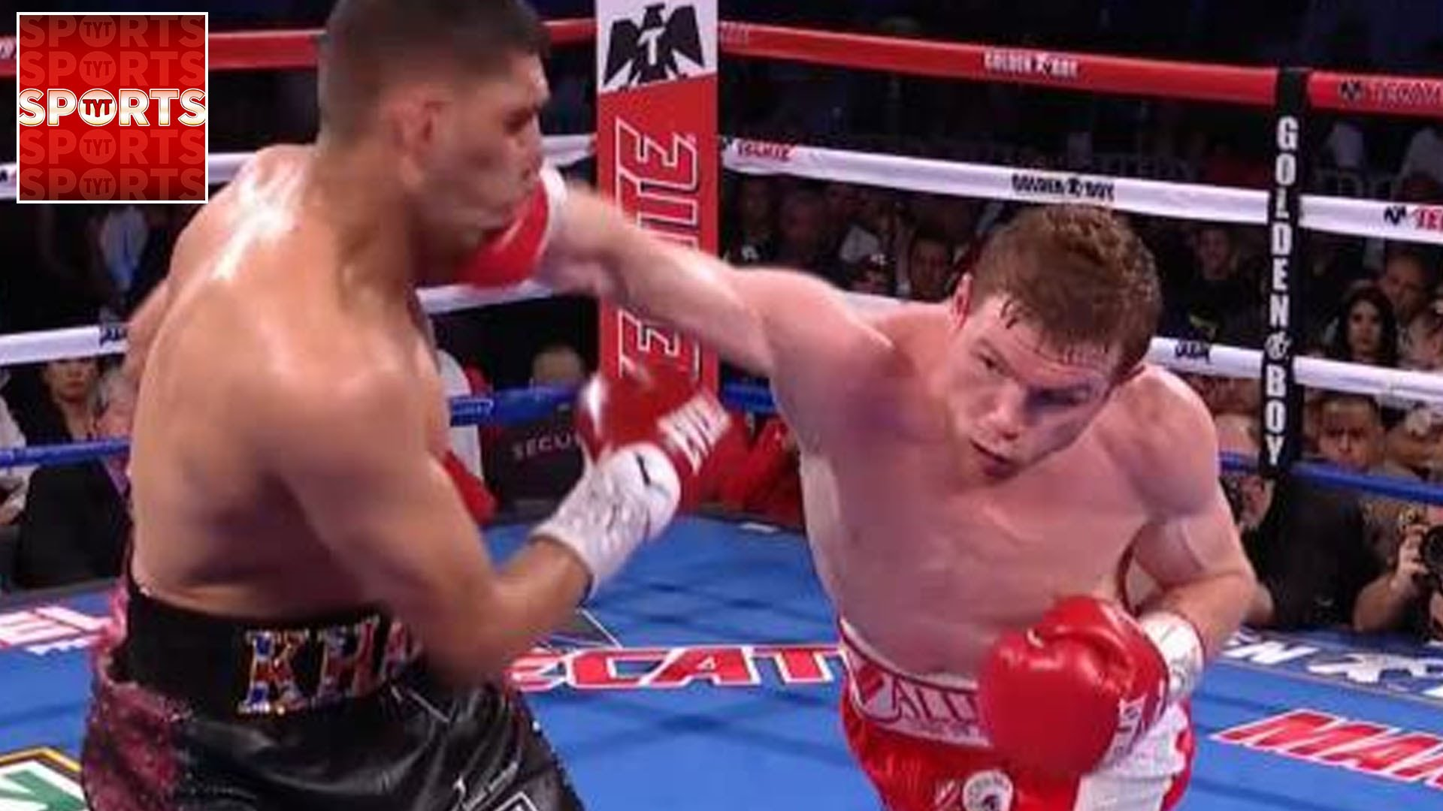
https://www.youtube.com/watch?v=LehQX1bbGQk
https://www.youtube.com/whttps://www.youtube.com/watch?v=v977m7lUTEUatch?v=v977m7lUTEU

Slide 24

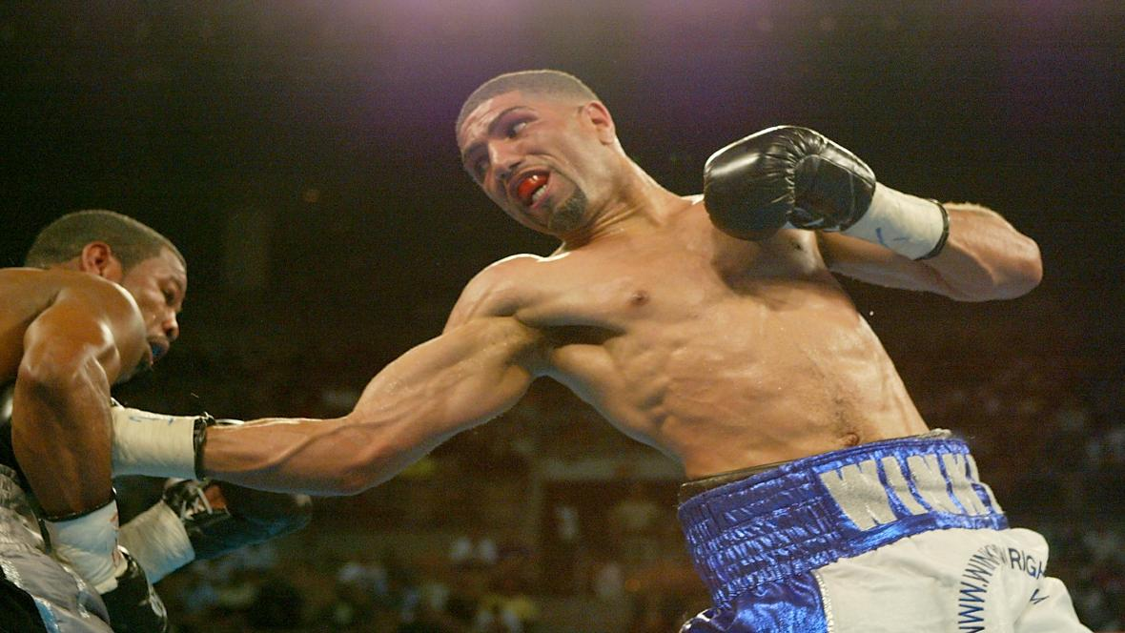
POWER PUNCHES

Slide 25
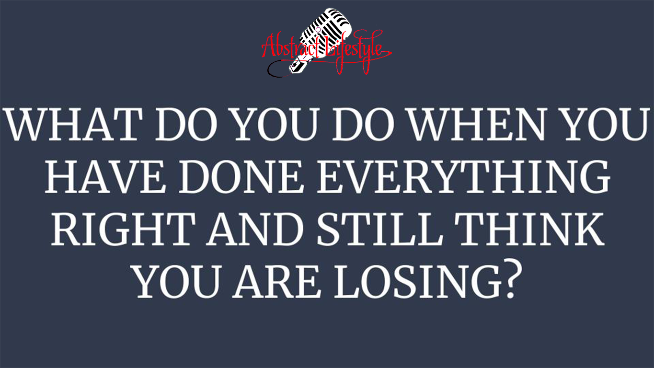
WHAT DO YOU DO WHEN YOU HAVE DONE EVERYTHING RIGHT AND STILL THINK YOU ARE LOSING?

Slide 26
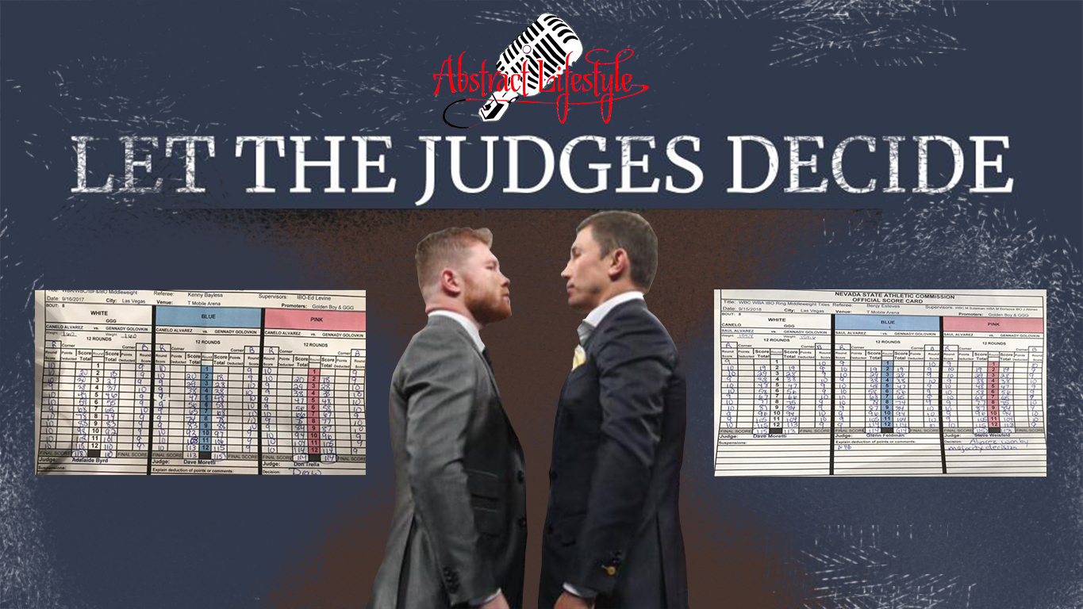
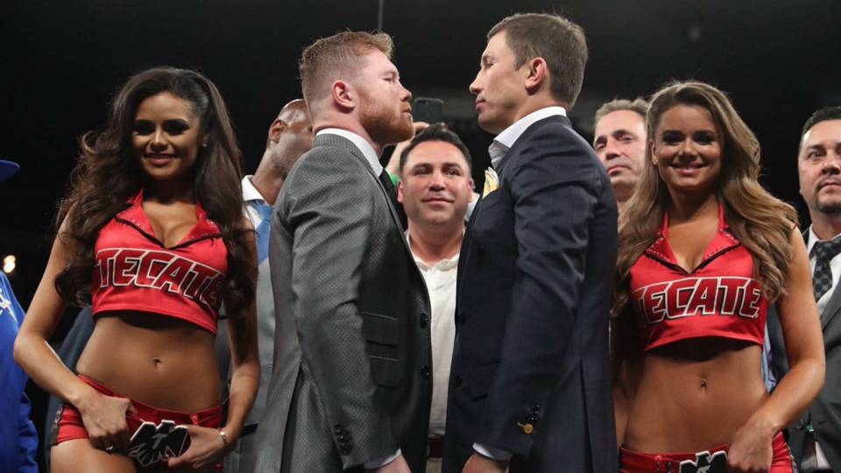
LET THE JUDGES DECIDE

Slide 27
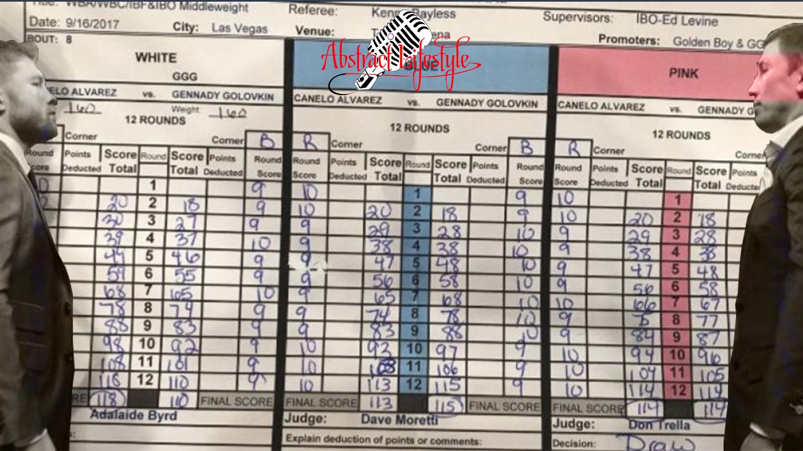
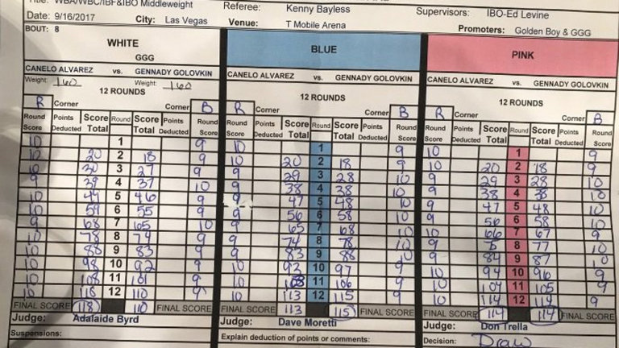
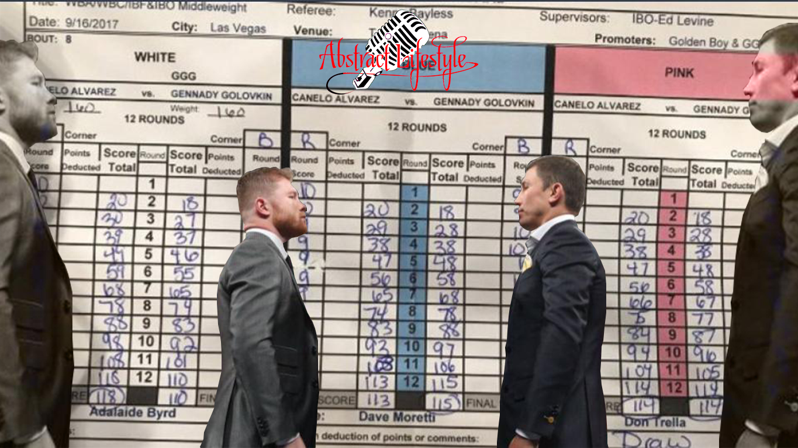

Slide 28
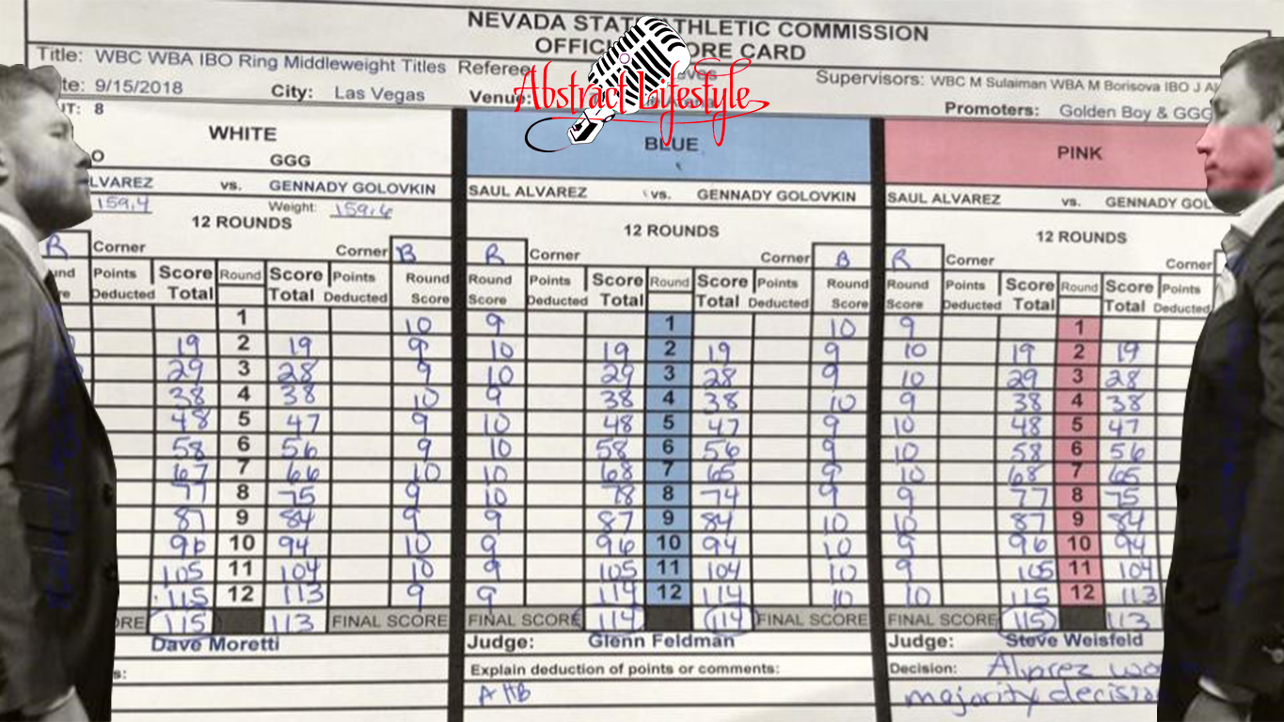
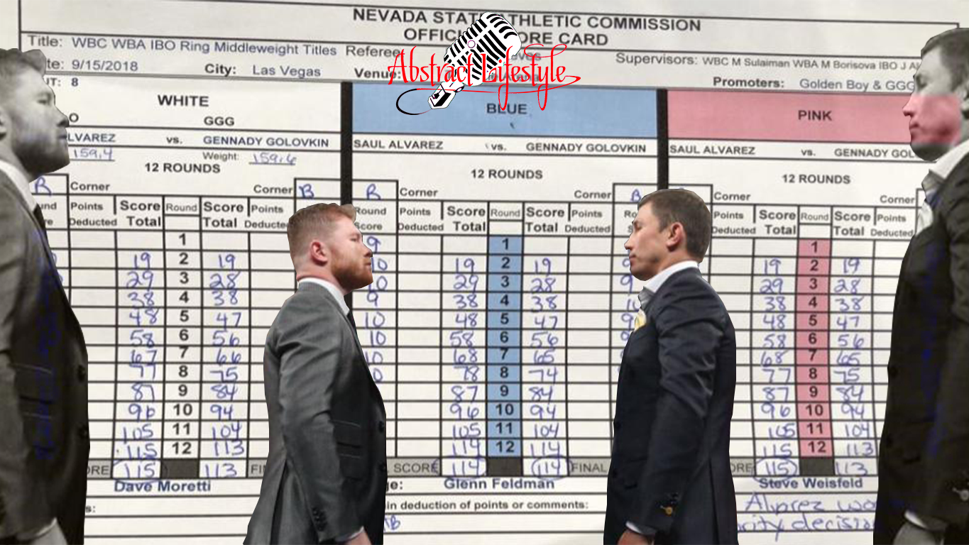

Slide 29

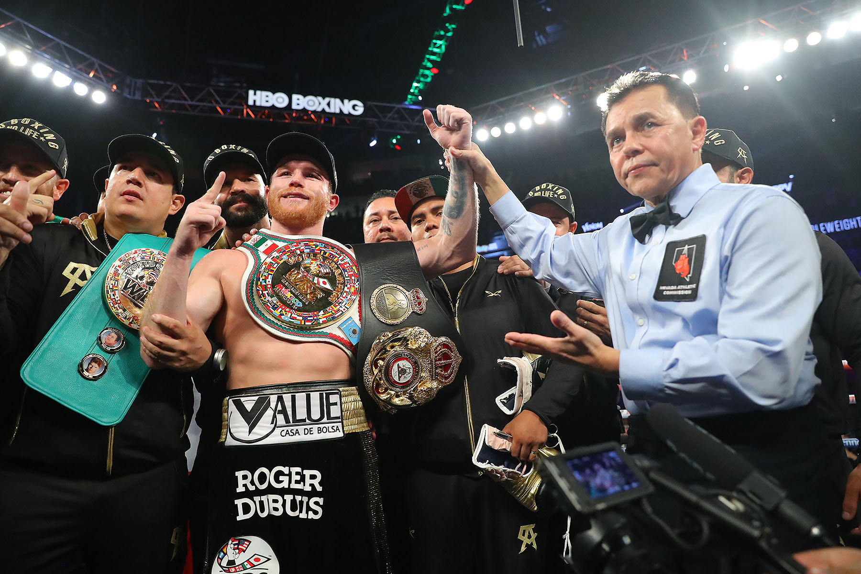


Slide 30

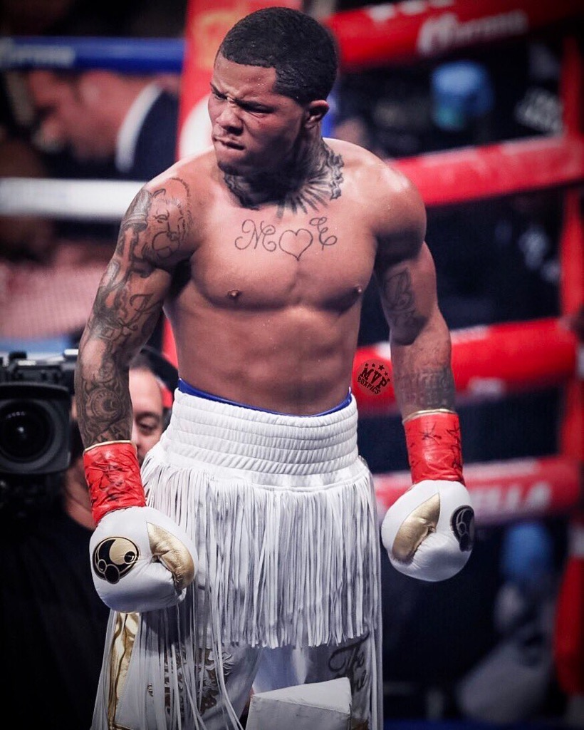

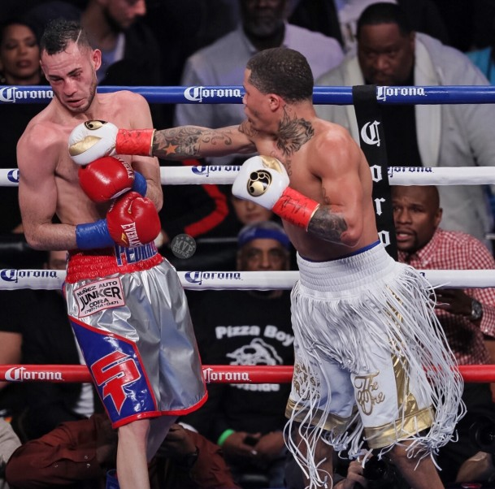

Slide 31

